Slide 1
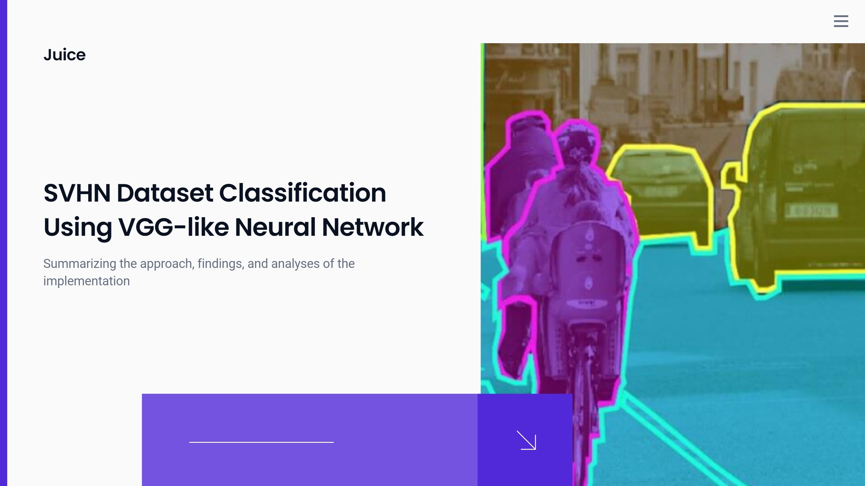

Slide 2
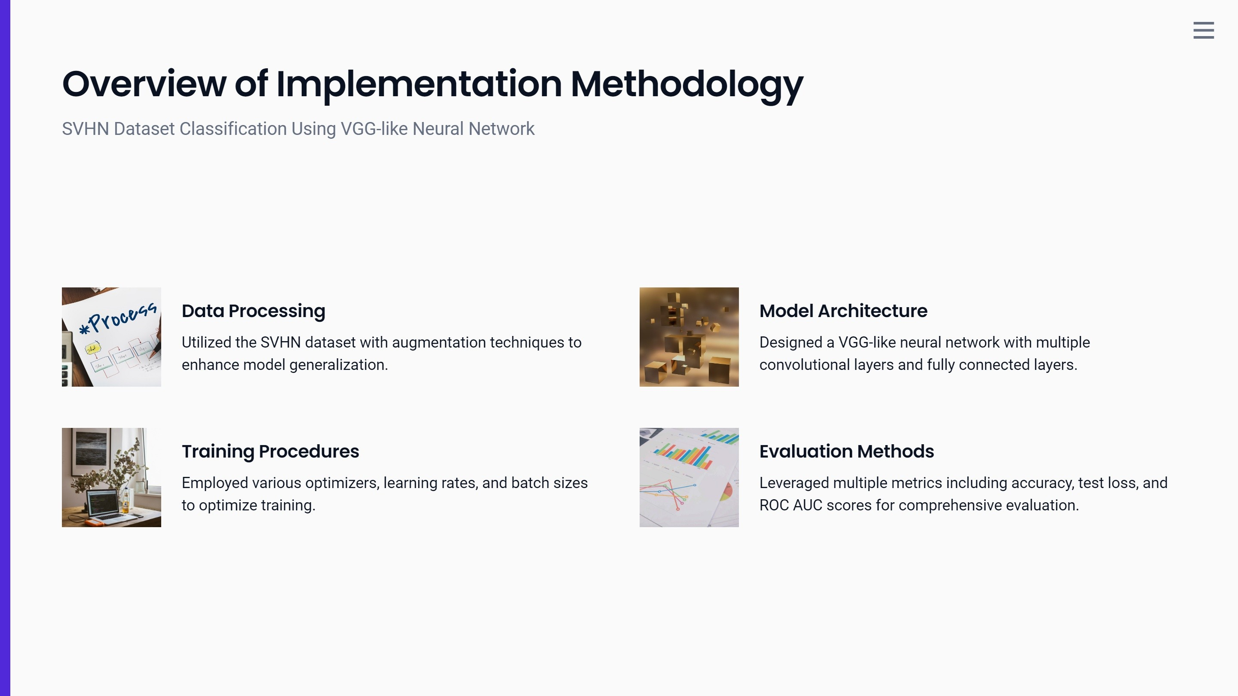

Slide 3
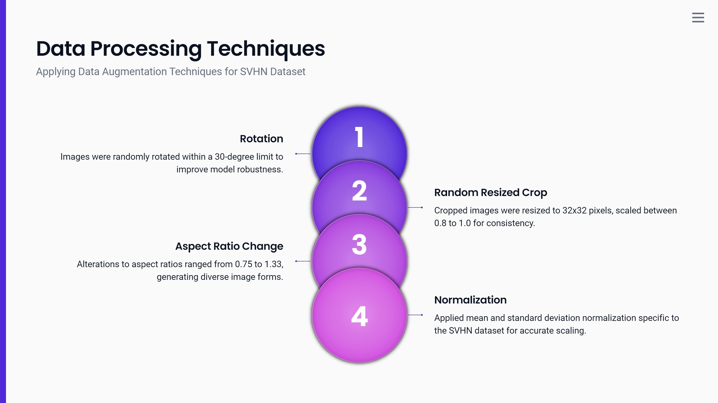

Slide 4
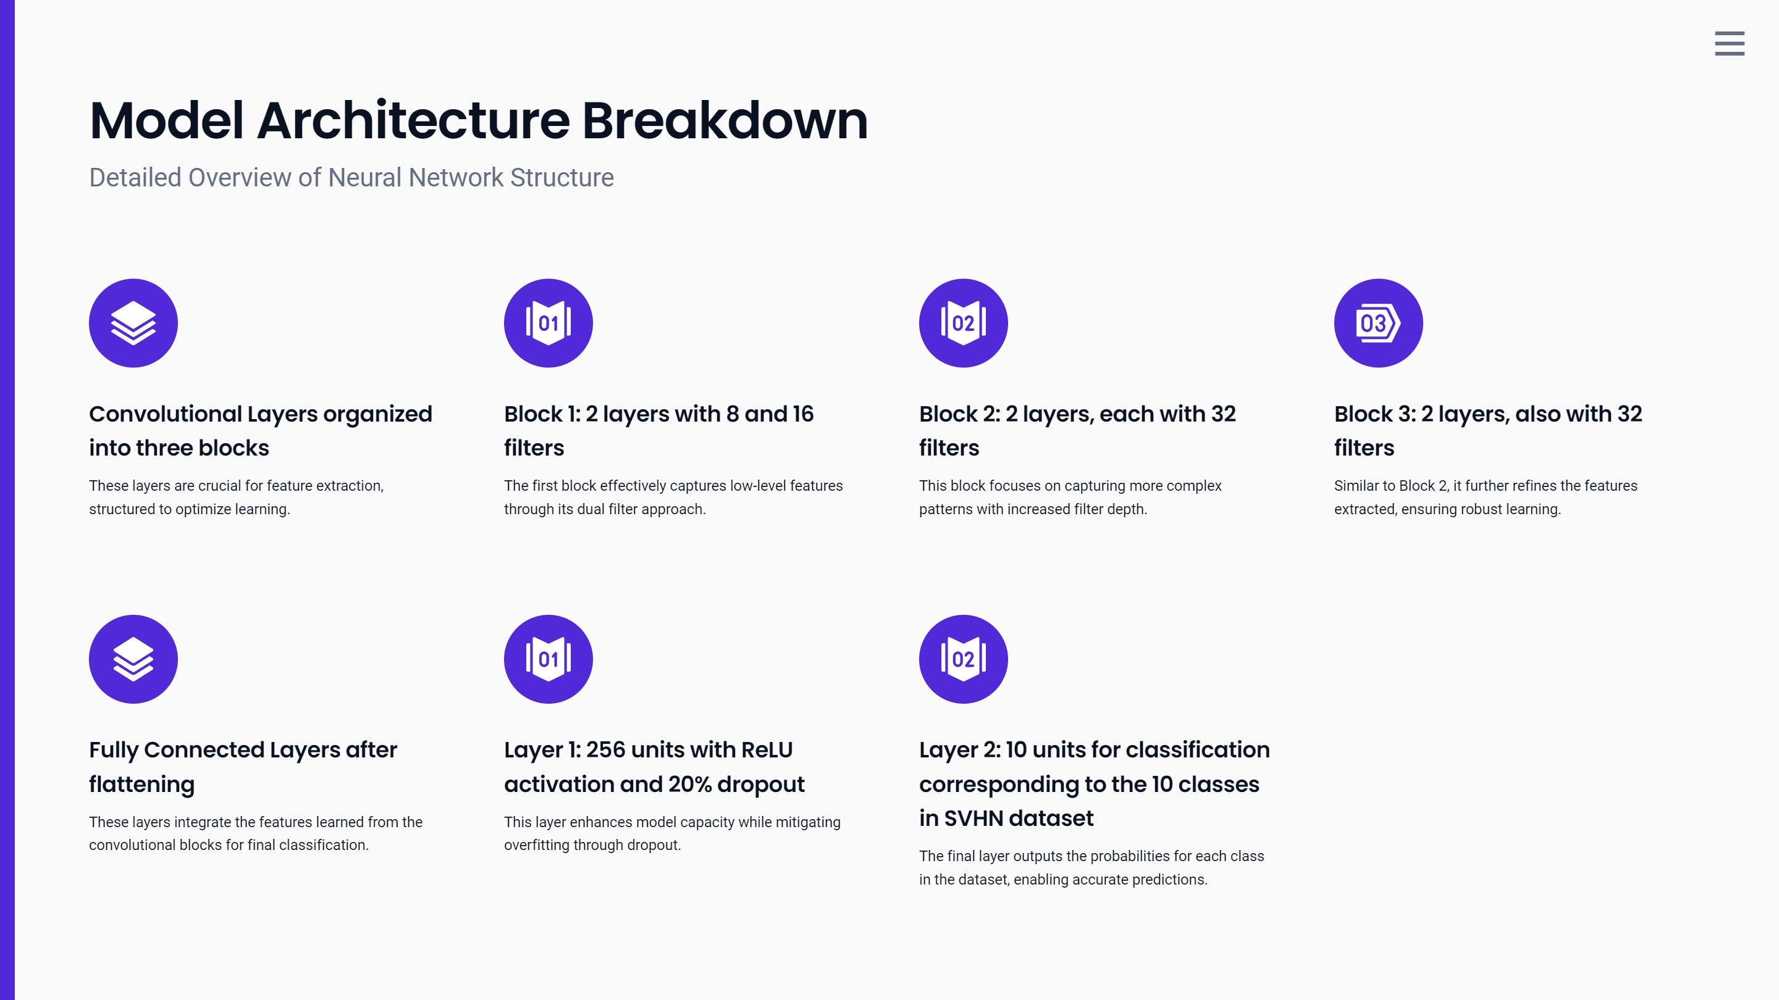

Slide 5
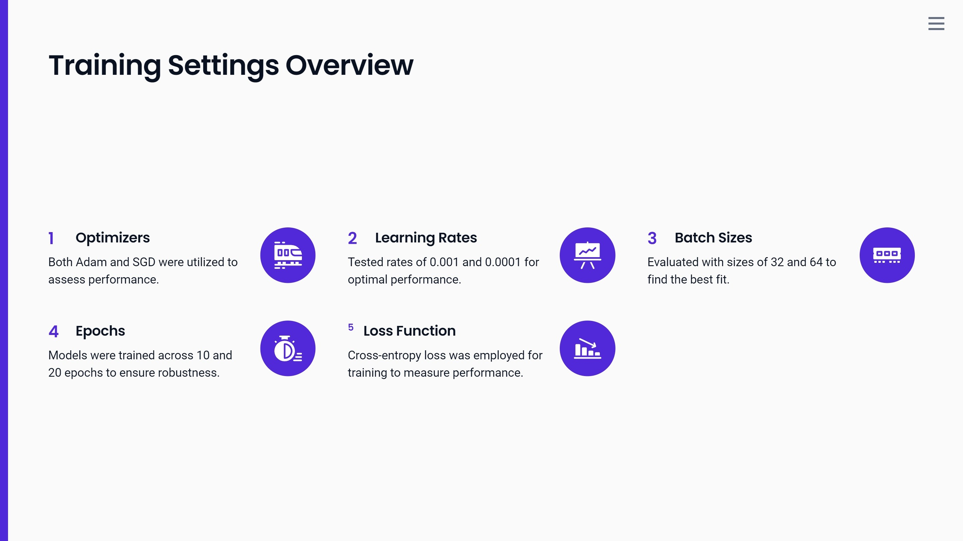


Slide 6
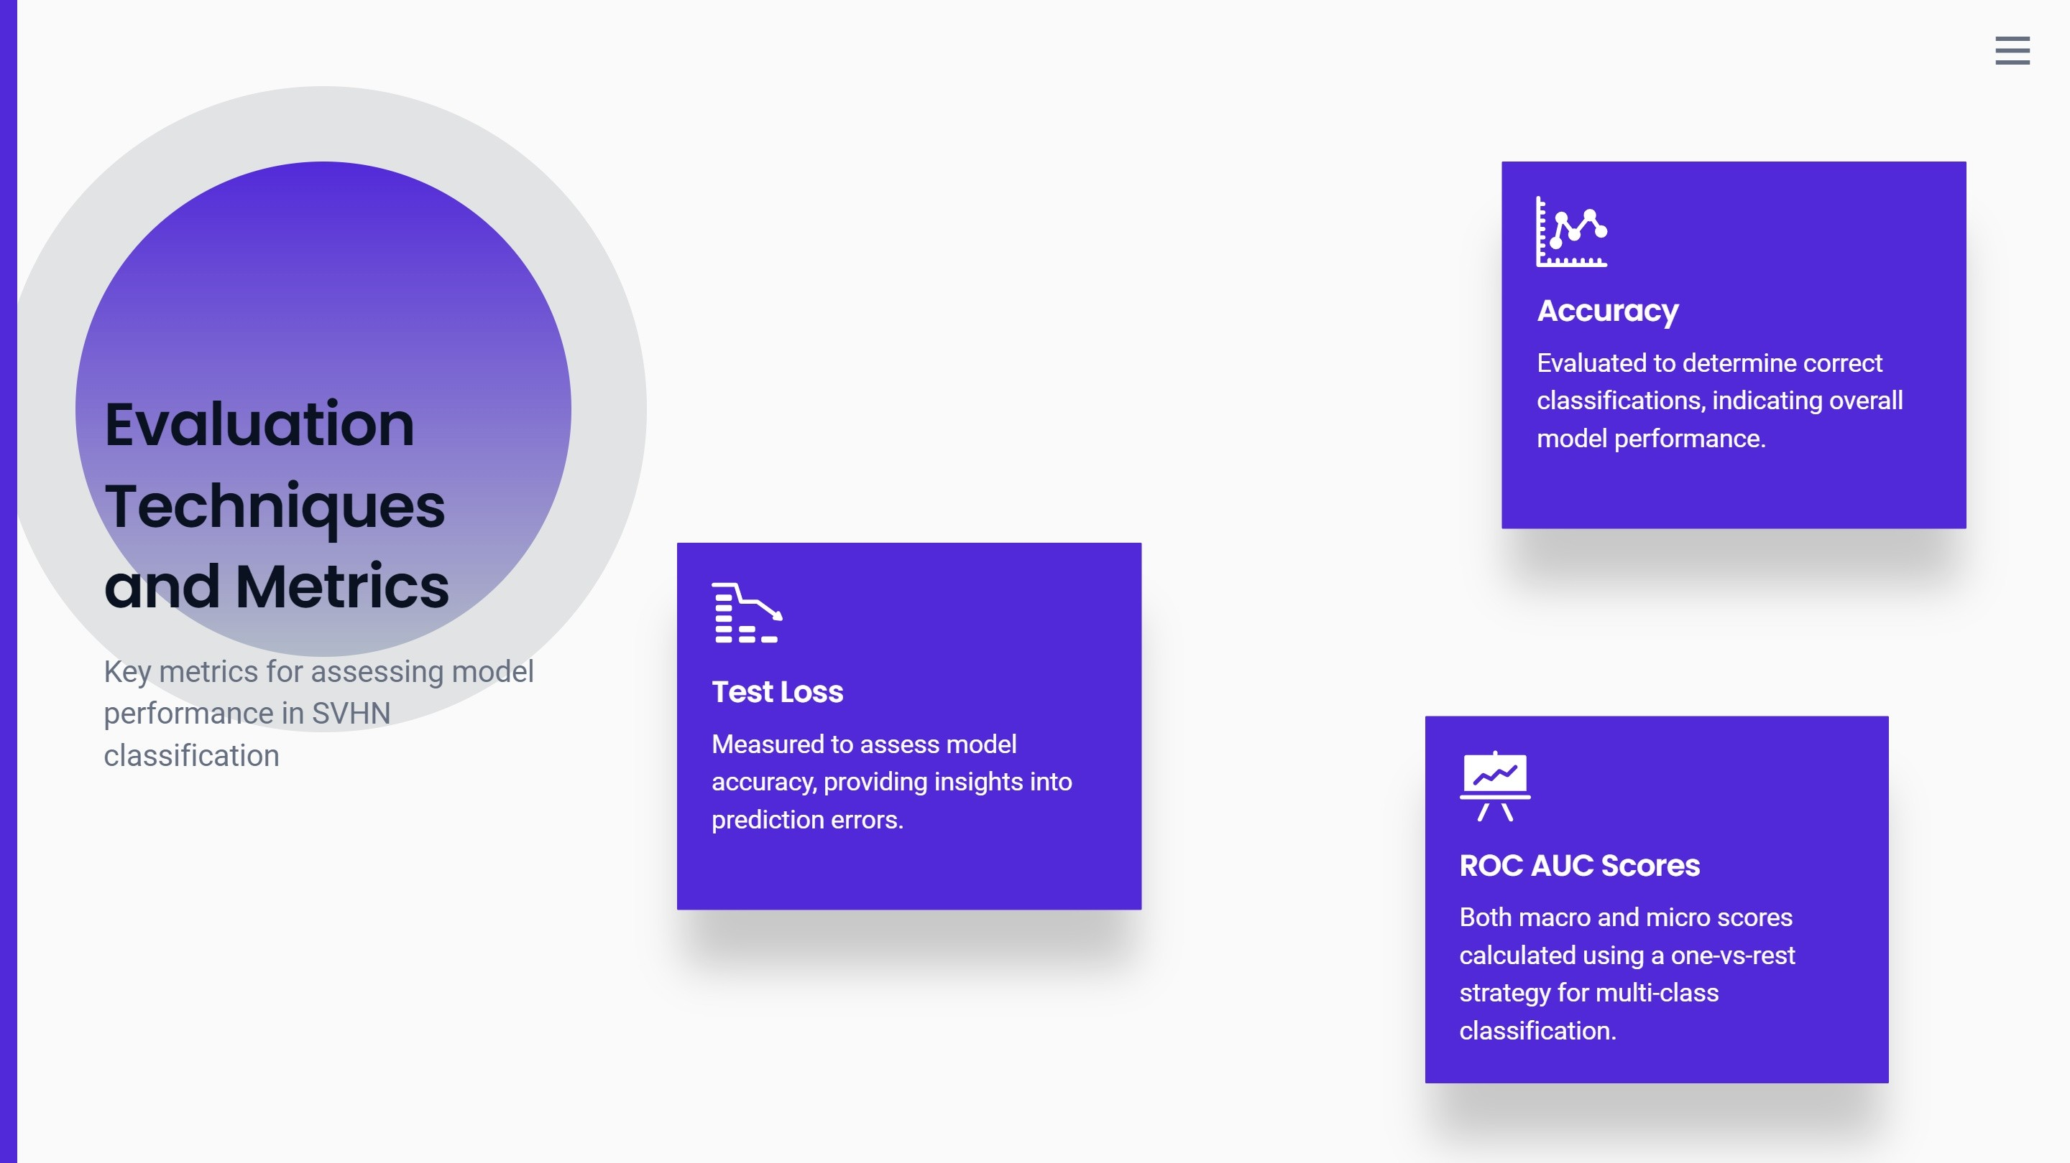

Slide 7
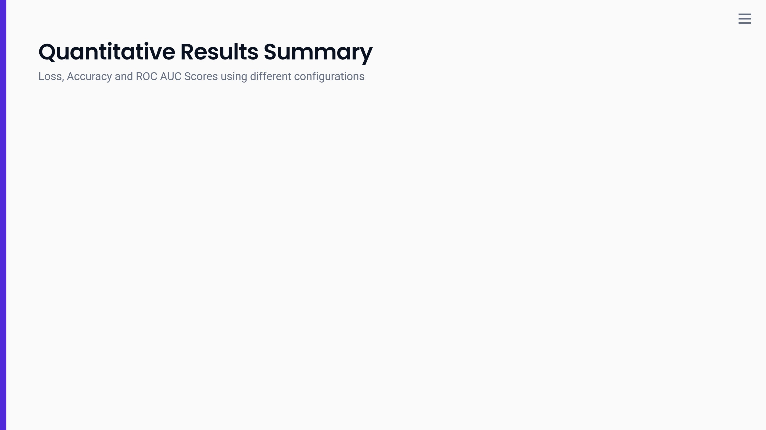
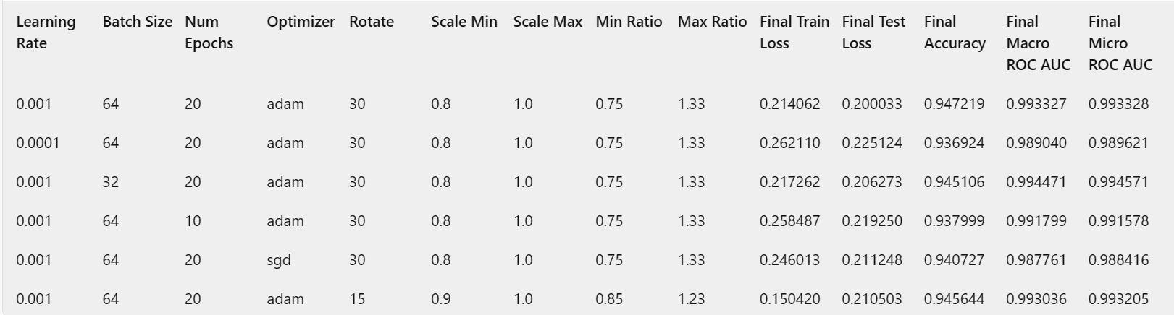

Slide 8
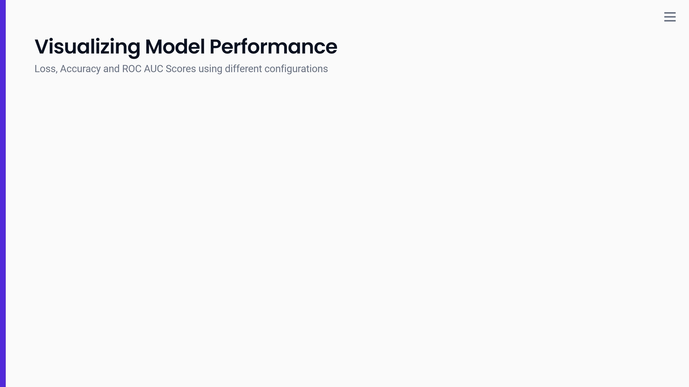
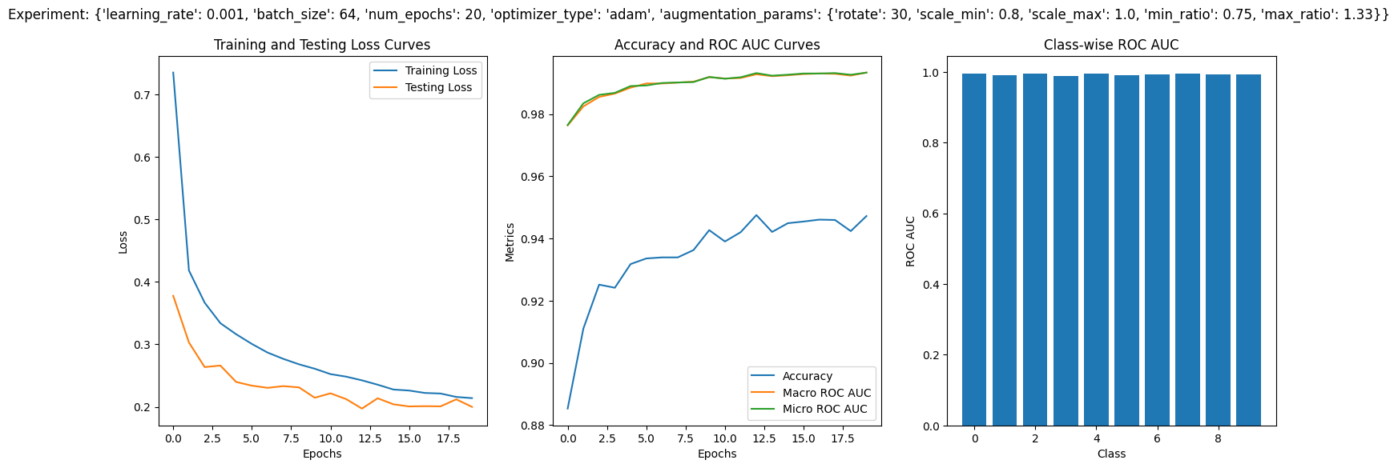
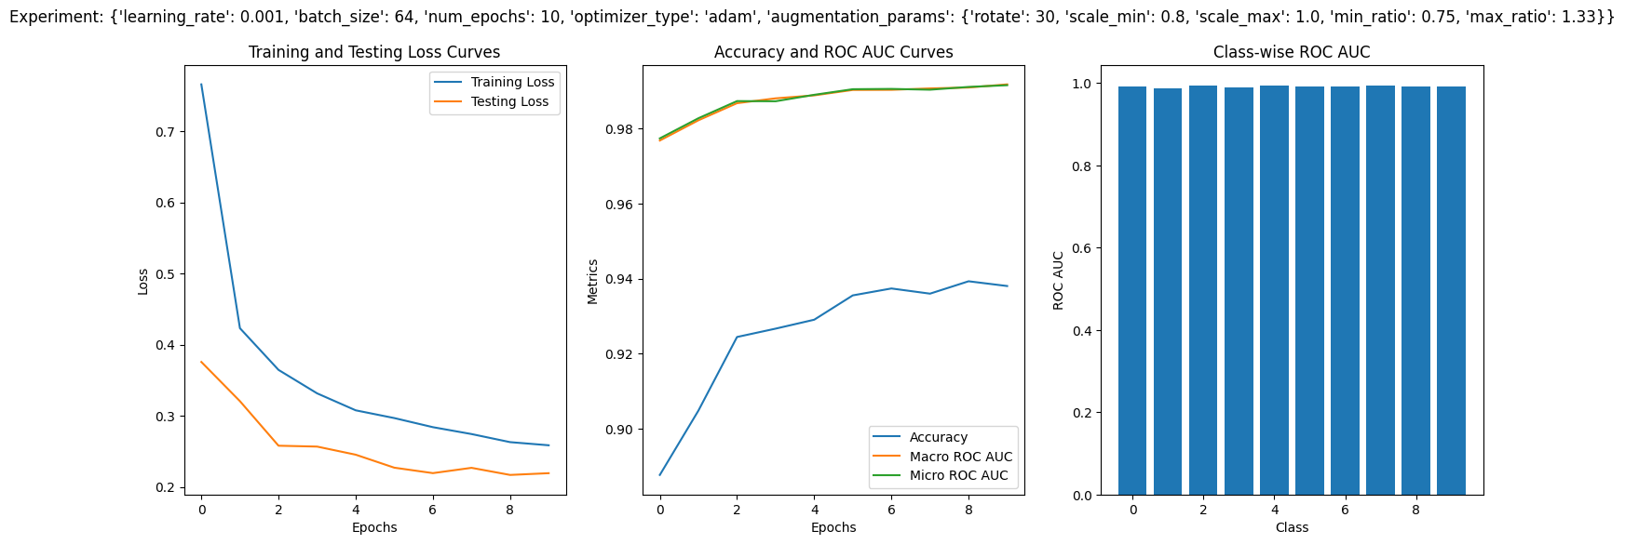





Slide 9
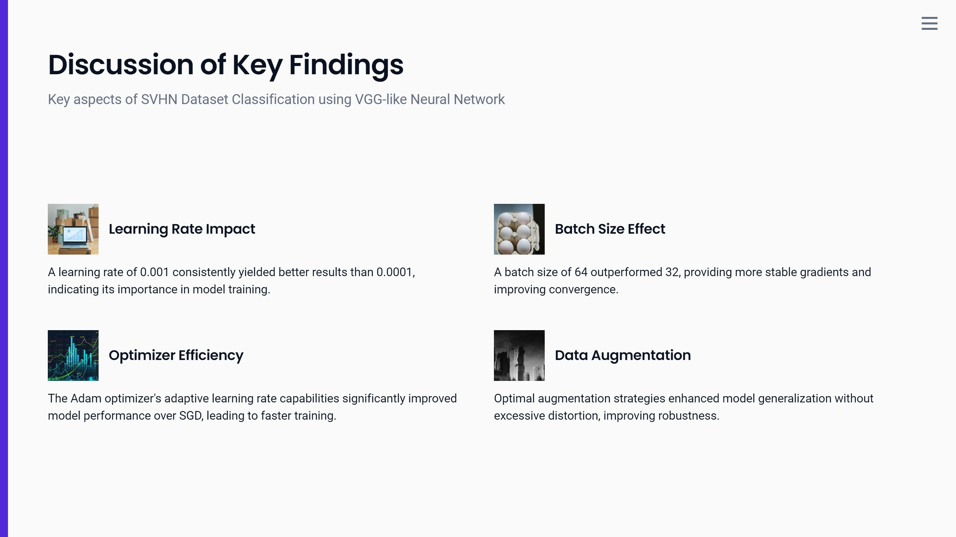

Slide 10
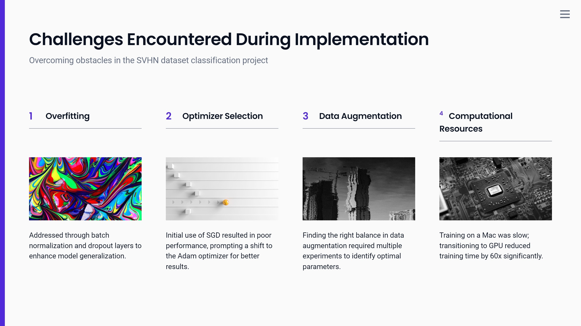


Slide 11

Conclusion and Future Directions
Optimal Hyperparameters Identified：
The best hyperparameters included a learning rate of 0.001 and a batch size of 64, using the Adam optimizer.
2. Future Architectural Improvements：
Future work could explore deeper architectures, such as ResNet, to further enhance classification performance.
3. Advanced Data Augmentation Techniques：
Implementing advanced data augmentation could lead to improved model generalization and robustness.
4. Incorporating Attention Mechanisms：
Incorporating attention mechanisms could enhance the model's focus on important features, boosting accuracy.

